Slide 1

Cloud Computing Internship
Unity Technologies
Emily Krasser

Slide 2
Live Notes
A live commenting service in the Unity Engine
Converse with your team directly in the editor
Create notes associated with GameObjects in a scene or assets in your project

Slide 3
Expectations, Environments, & Tools
Expectations
Daily standup, Weekly check-ins, Design meetings
Worked closely with another intern
Environments & Tools
Architecture: Client - Server
Management: Github, Jira
Languages: C#, C++, GoLang
Platforms: GCP, Kubernetes
Notes:
Activity: 3:15-3:30

Slide 4
Features

Slide 5
Edit Note
Before:
Delete and re-add note with changes
After:
Simply edit the note and save with desired changes
Create a workflow to allow users to easily modify the contents of their notes

Slide 6
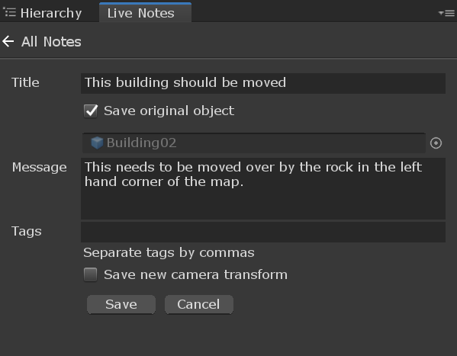

Slide 7
Bulk Selection & Actions
Before:
Users could only perform actions on each note individually
After:
Users were able to select multiple notes at once to perform these actions on as a group
Create a workflow for users to easily perform actions on multiple notes at one time: mark as read/unread, delete, etc.
Notes:
Explain that students have been using events already, and there are other kinds of events.

Slide 8
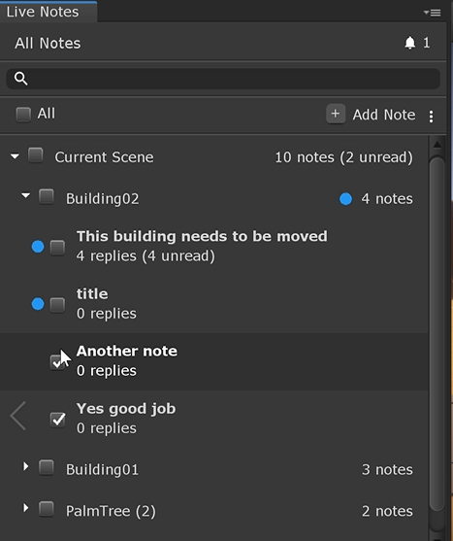

Slide 9
Tagging & Filtering
Before:
Predetermined filters: Scene, Object, Read/Unread
After:
Custom tags and filters along with the previous, predetermined filters
Create a workflow to allow users to create and search by custom filters on their notes
Notes:
Explain that students have been using events already, and there are other kinds of events.

Slide 10
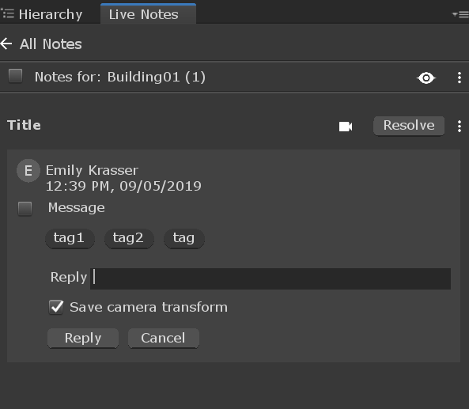
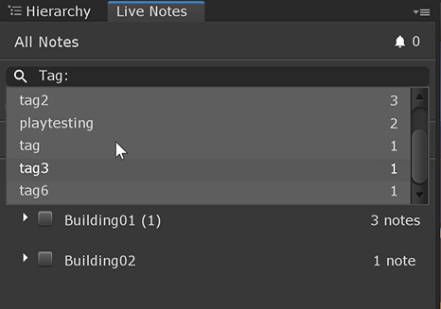

Slide 11
Note Icons
Before:
No indication that objects had notes attached to them
No way to access notes attached to an object via said object
After:
Indication (icon) that an object has notes attached
Ability to view notes on object by selecting icon
Notify the users of objects that have notes attached to them and create a workflow to access notes from a specific object
Notes:
Explain that students have been using events already, and there are other kinds of events.

Slide 12
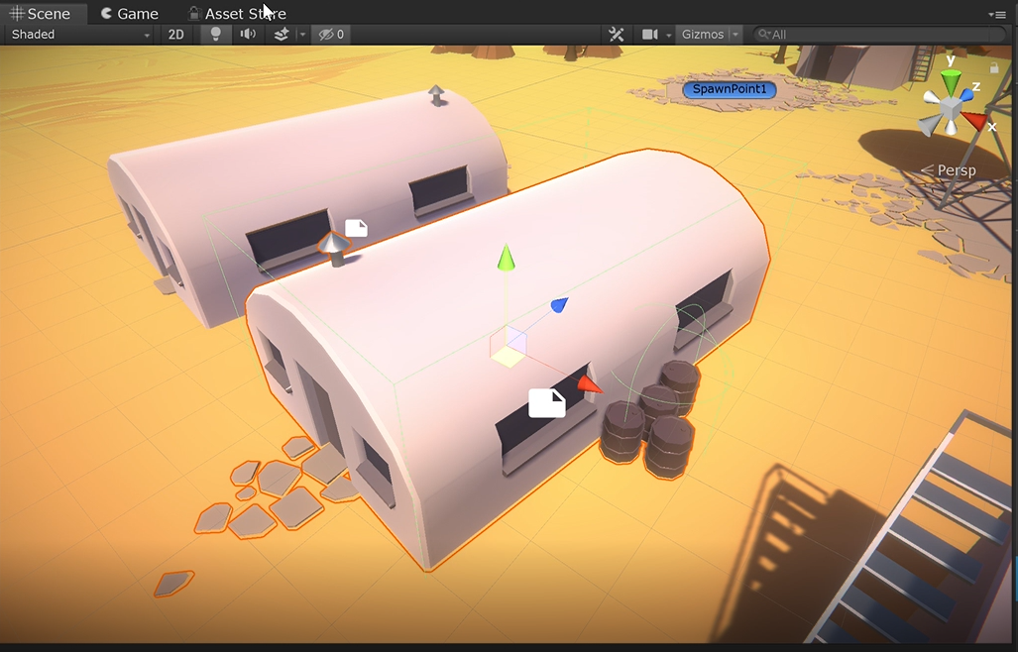

Slide 13
Playmode Notes
Before:
Users were unable to consistently create notes during playmode
After:
Users have the ability to create notes during playmode under a generic ‘playmode’ object
Create a workflow that allows users the create notes while in playmode
Notes:
Explain that students have been using events already, and there are other kinds of events.

Slide 14
Conclusion
Contributed to a project that will eventually ship with the Unity Engine as a package
While the package was not made production-ready during the internship, it is much closer than it was
Improved my programming and problem solving skills
Made me much more comfortable in my abilities
Taught me how to learn at a much faster rate than I was used to
Made meaningful changes and contributed to a tool that I use in my daily life

Slide 15
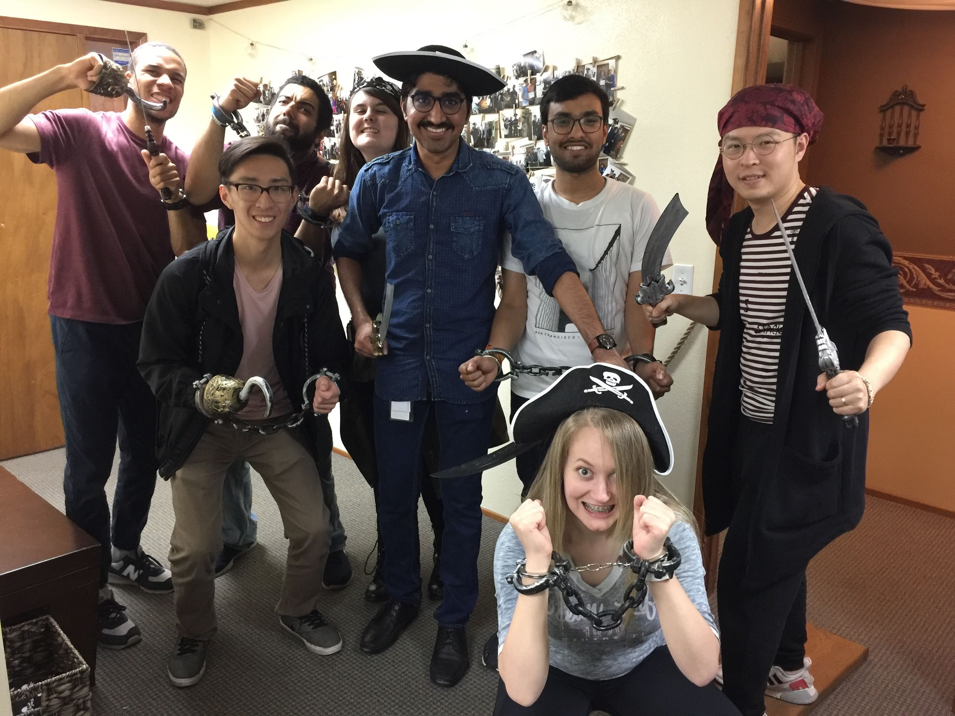
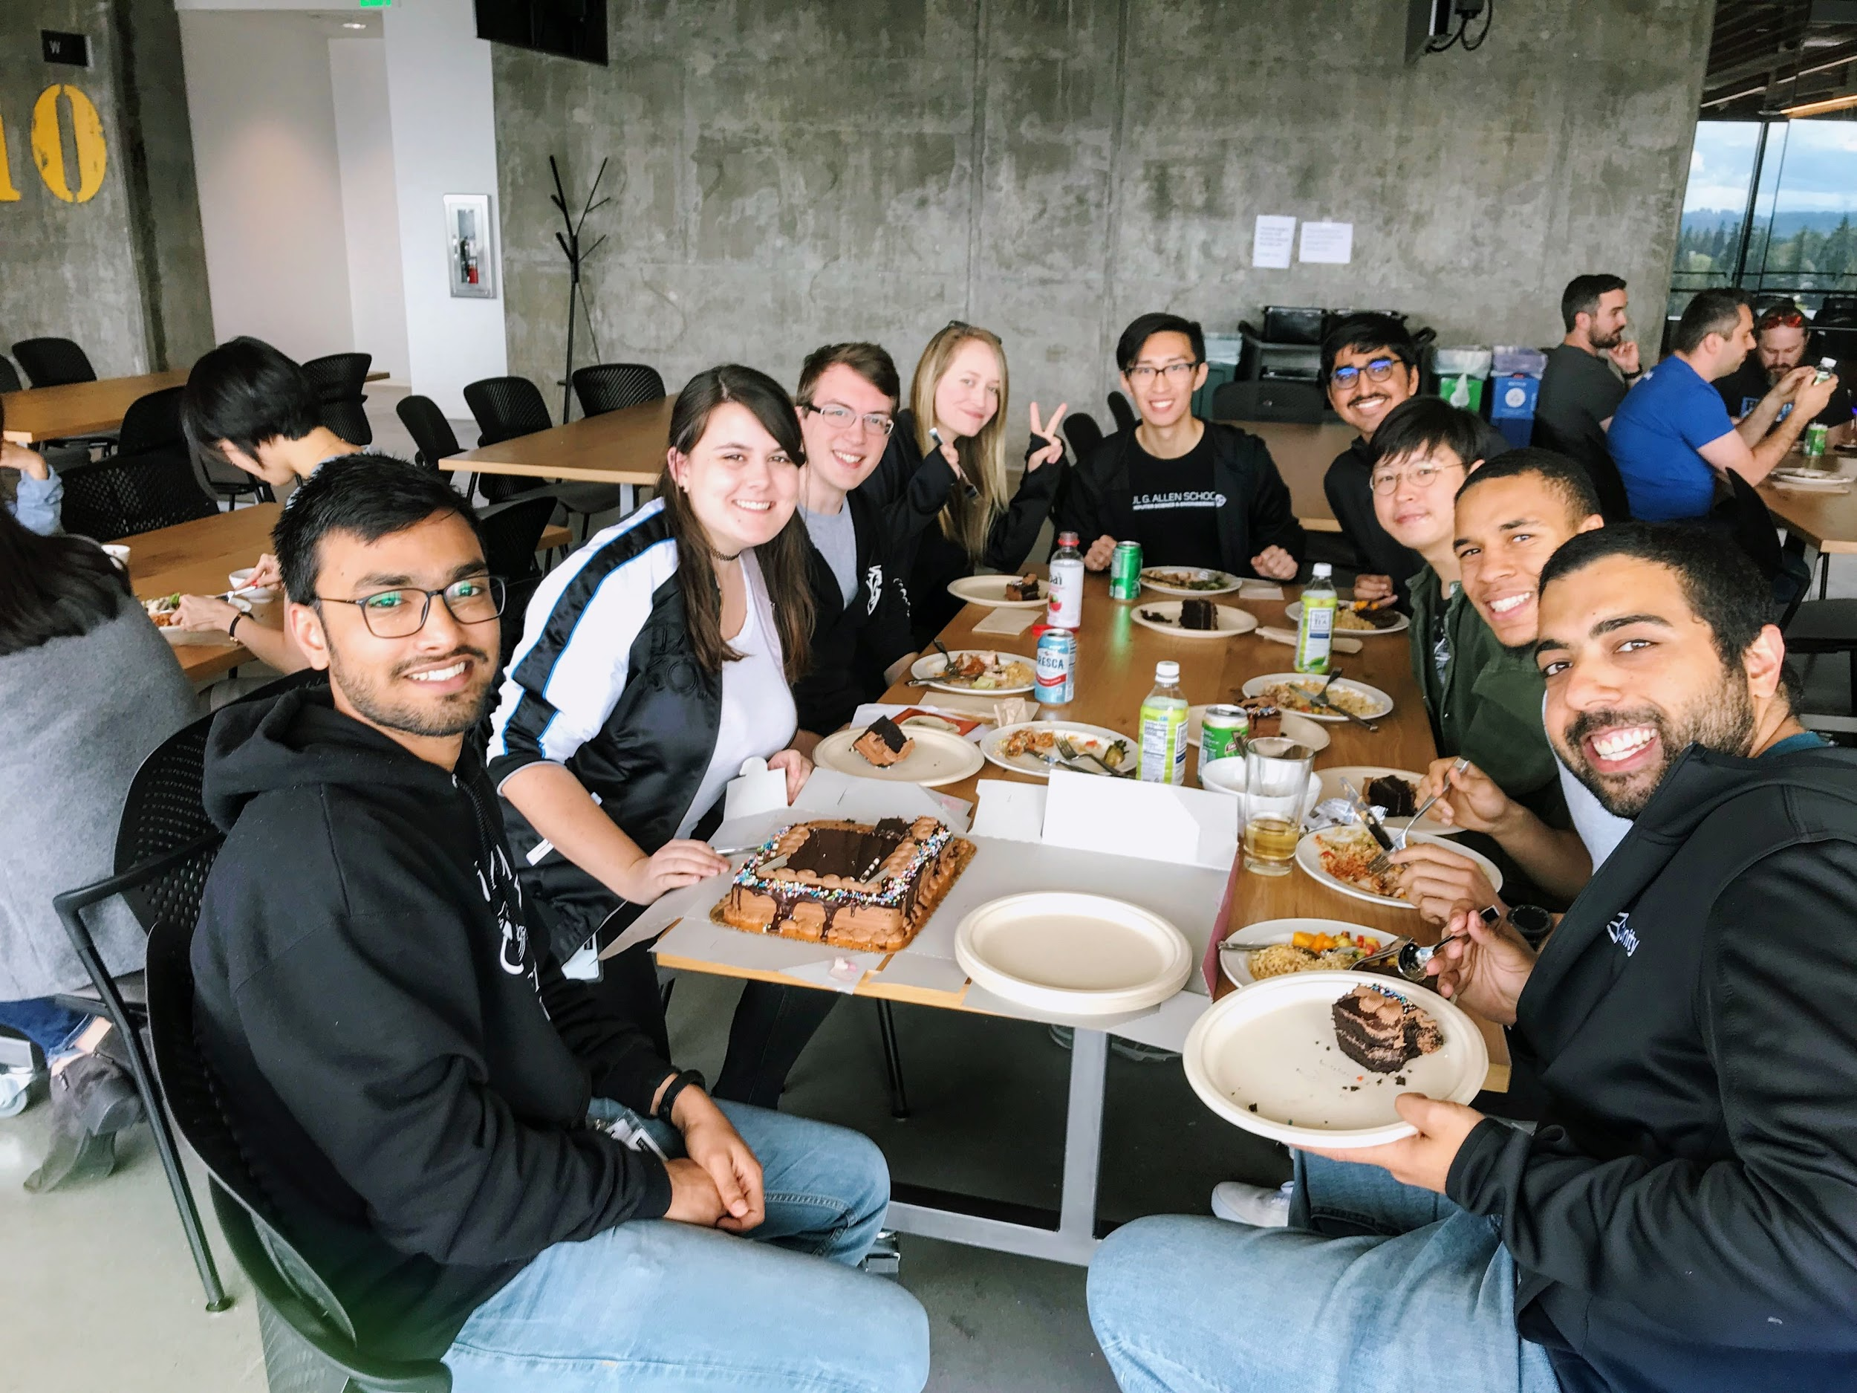
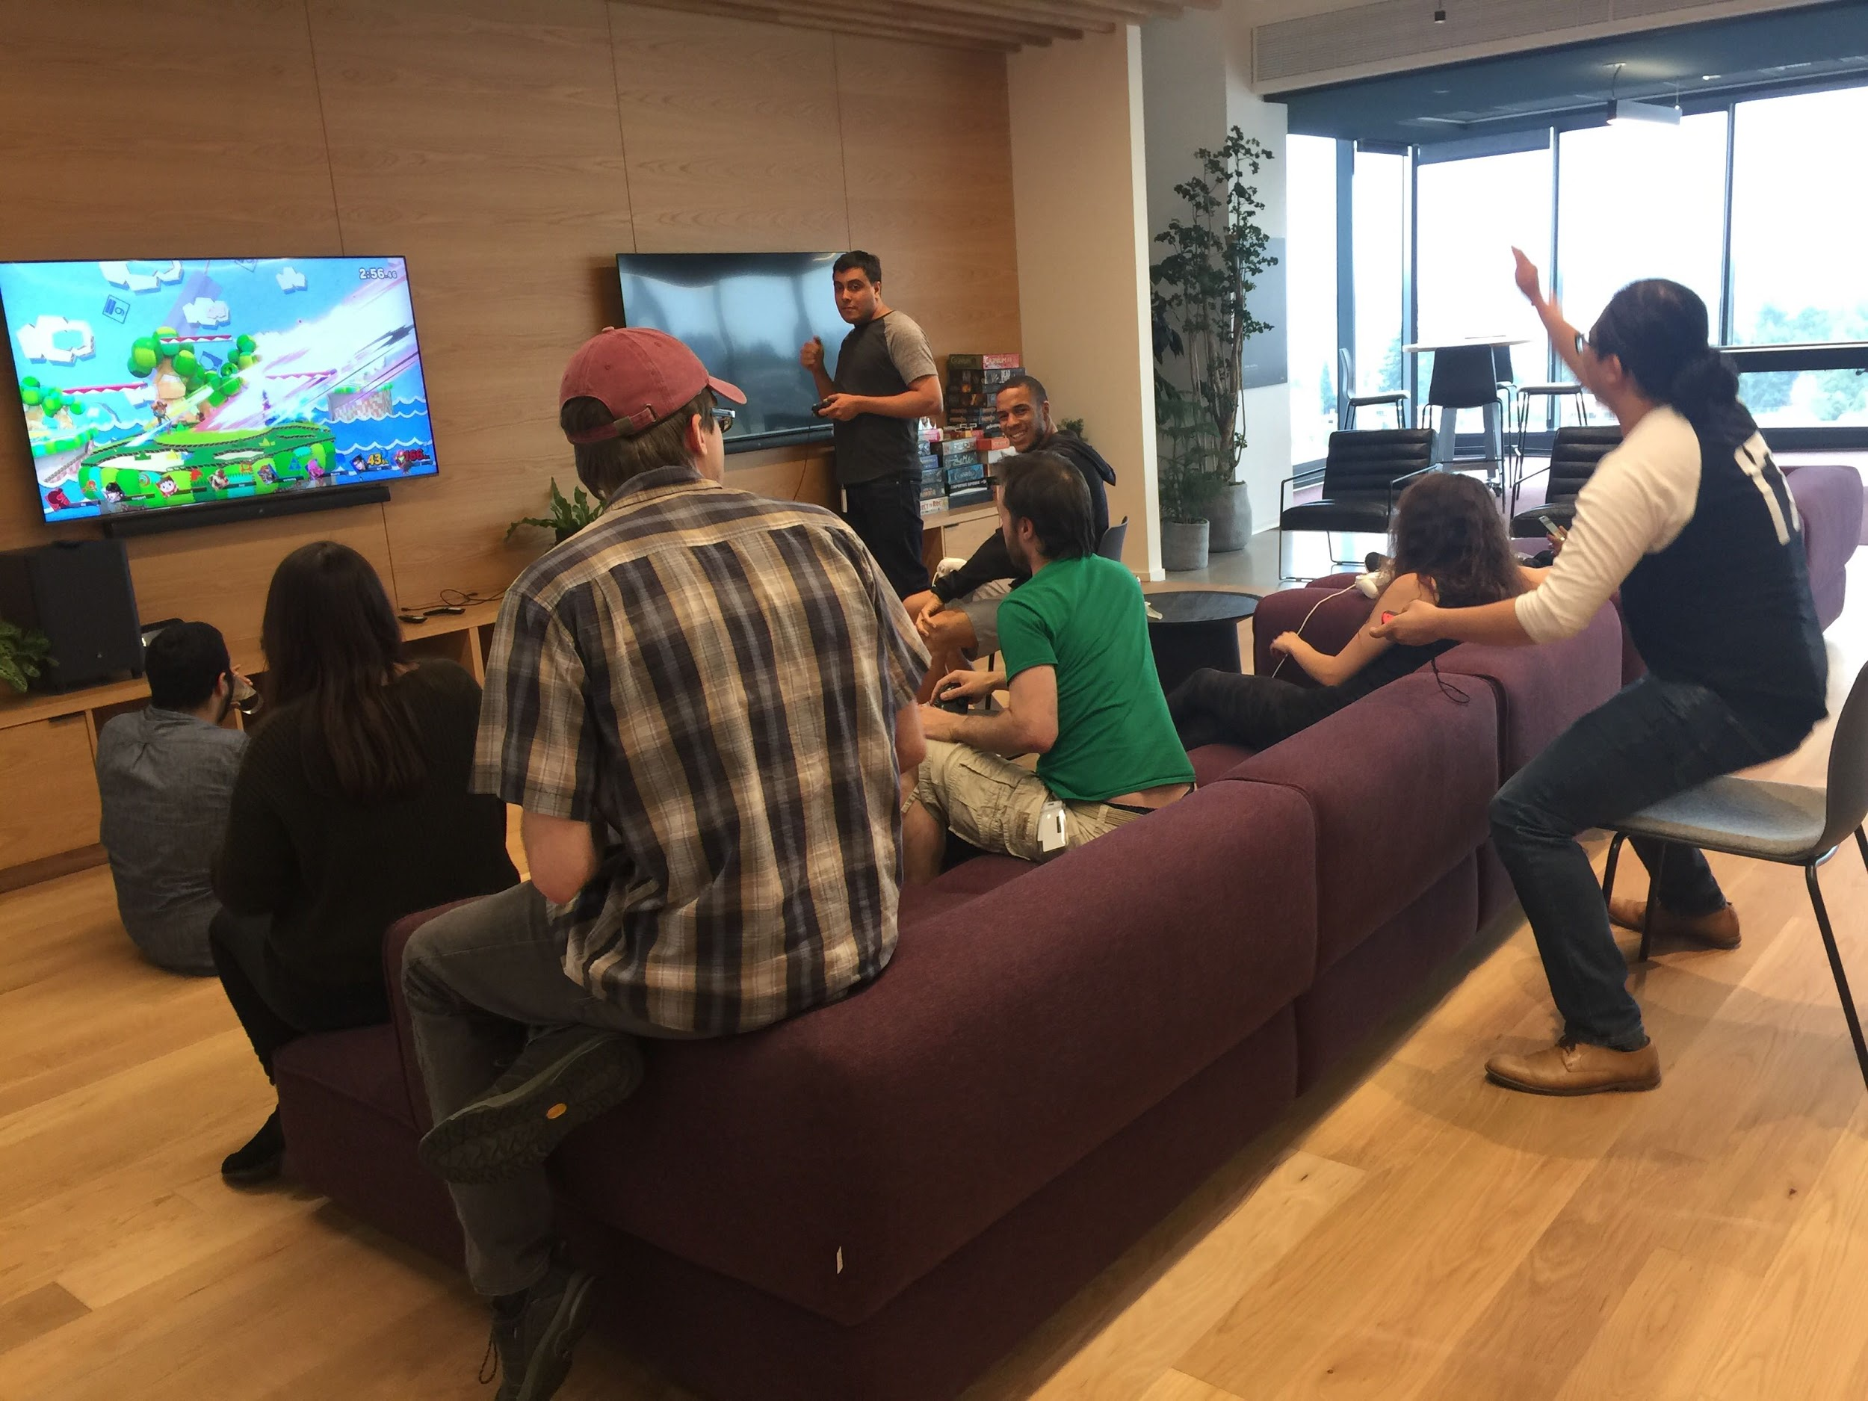
Questions?
emilylk@uw.edu

